Slide 1
Decarbonising Aviation: Exploring the consequences

Slide 2
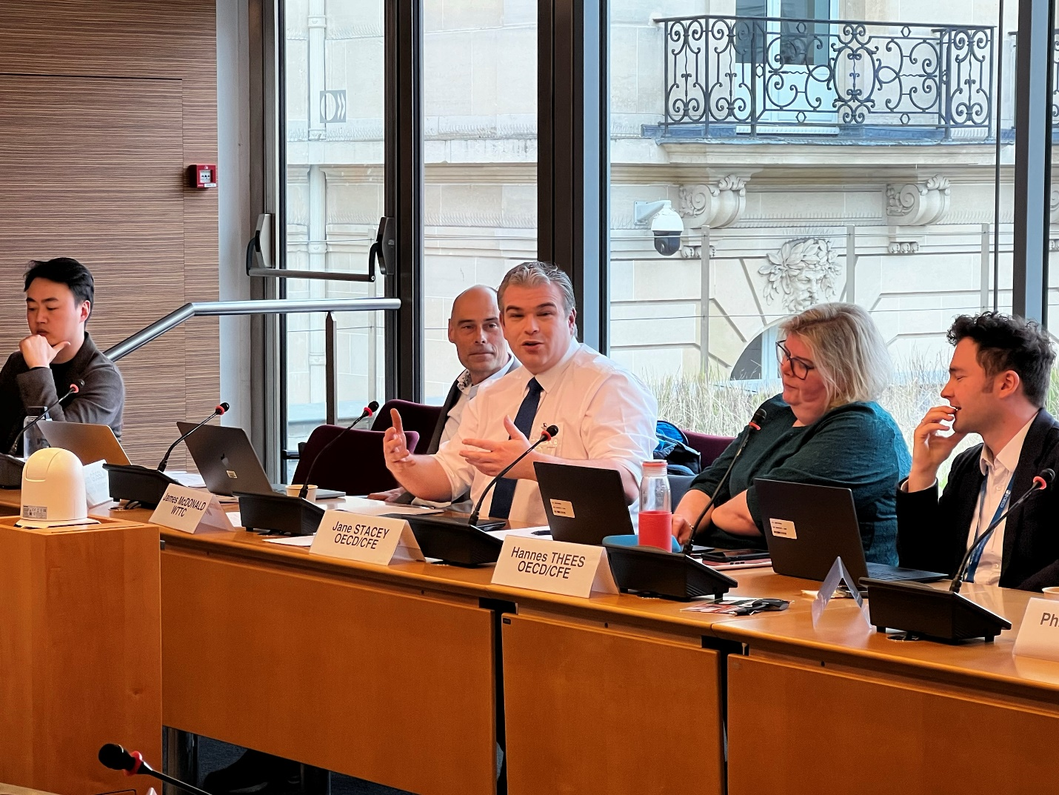
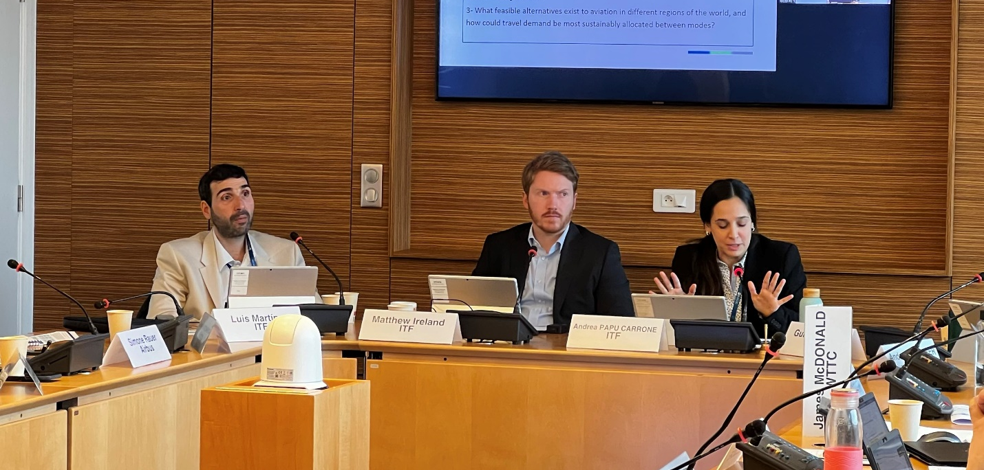
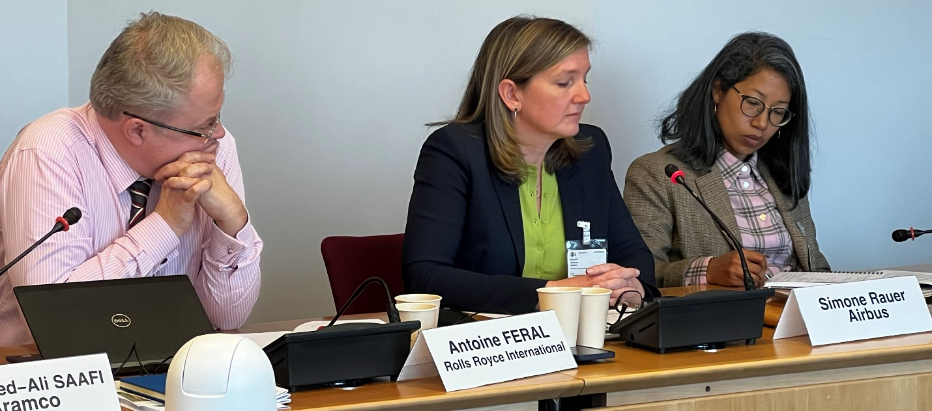
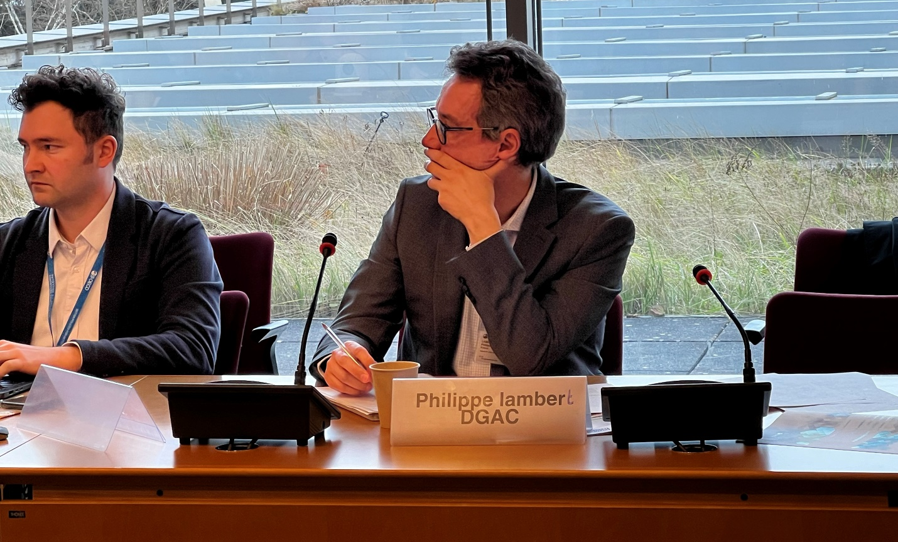
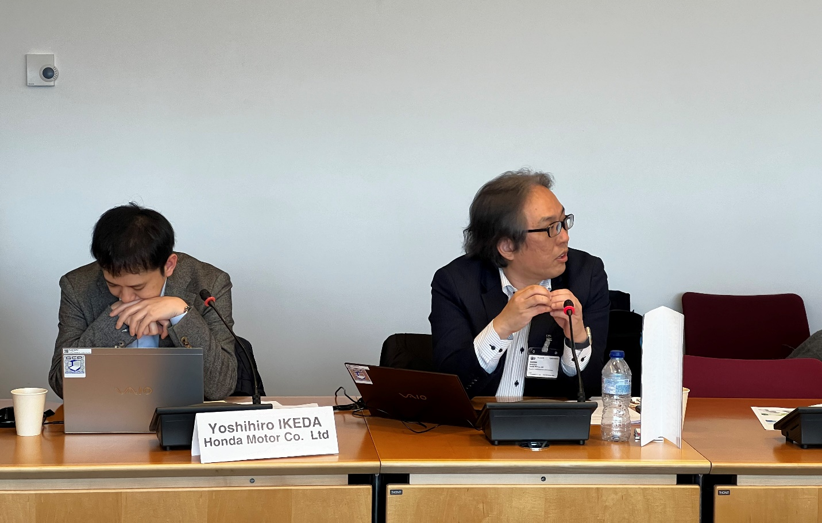
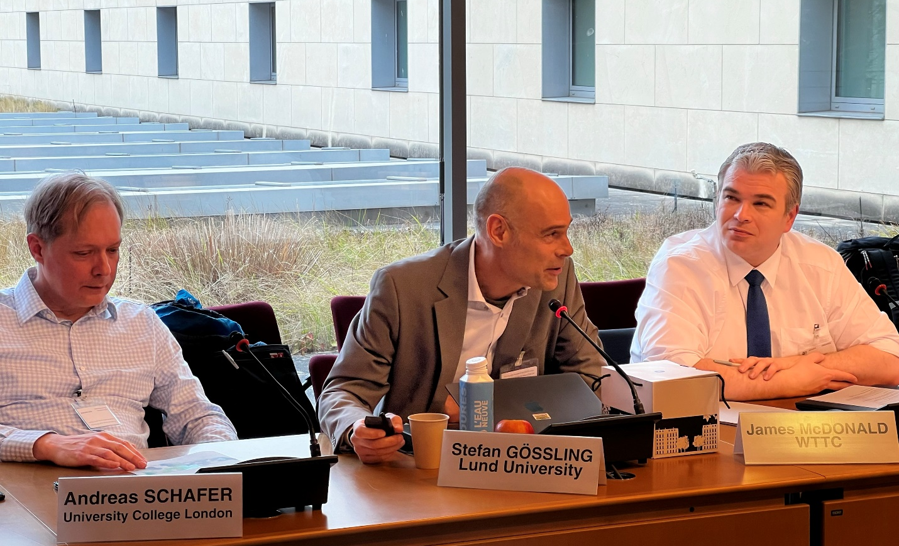
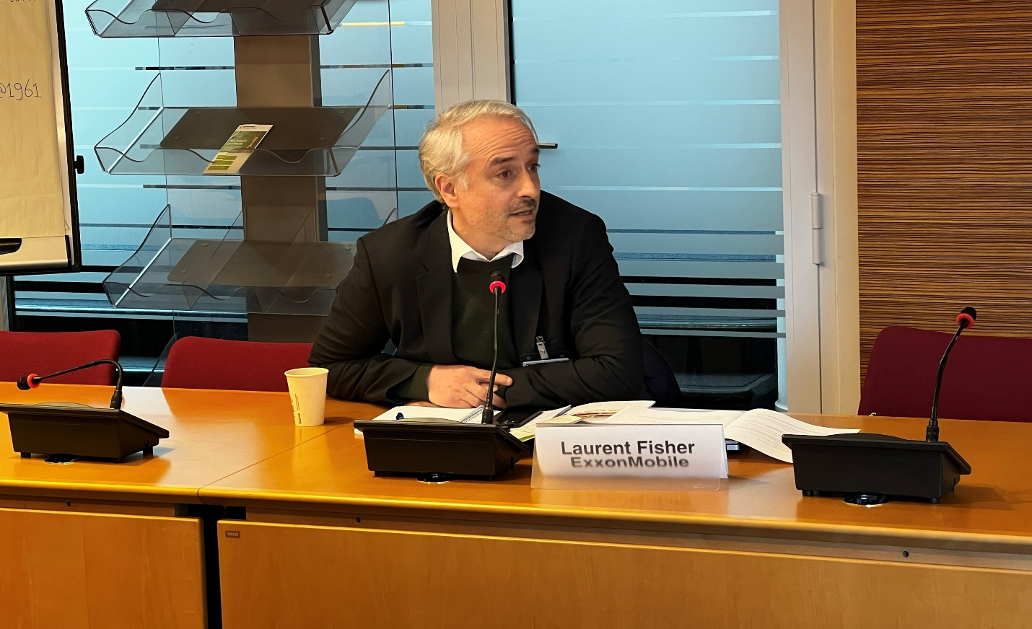
Setting the context
On 13 March 2024, the ITF organised an expert workshop to feed into a new CPB project, Decarbonising Aviation: Exploring the consequences.
49 experts from academia, industry, think tanks, and public authorities were present online and onsite to provide insights and participate in the discussions.
The outcomes of the workshop summarised here, along with the results of a modelling exercise and desk research will feed an ITF/CPB report to be published towards the end of 2024.

Slide 3
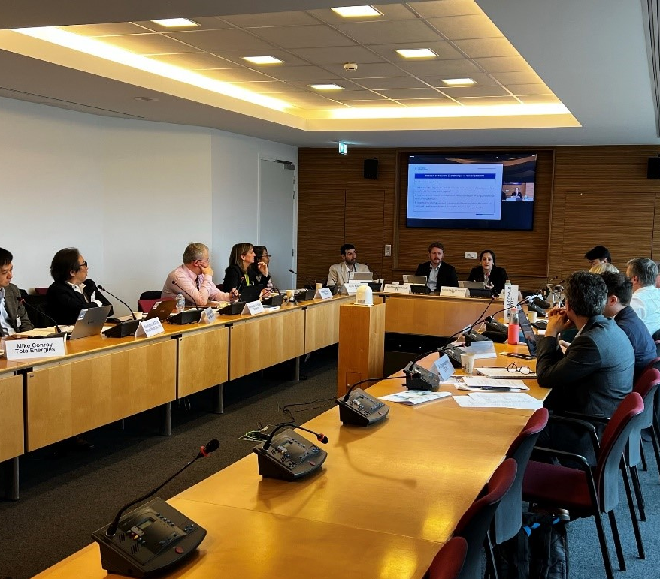
Project background
In October 2022, the International Civil Aviation Organisation (ICAO) set a challenging goal for net-zero carbon emissions in aviation by 2050. Achieving this objective requires a substantial reduction in carbon emissions from the sector. To facilitate this transition towards net-zero, governments are investing in Sustainable Aviation Fuels (SAF), supporting the development of new aircraft technologies, and considering different policy instruments. The adoption of cleaner fuels and aircraft, as well as the implementation of regulatory instruments, will impact costs that may translate to higher passenger and freight prices. As a result, the consequences of decarbonising aviation could include changes in travel patterns, air route connectivity, and impacts on the broader economy. This report will explore potential impacts and mitigation principles through environmental, geographic, macroeconomic and social lenses to help governments gain support for aviation decarbonisation policies.

Slide 4
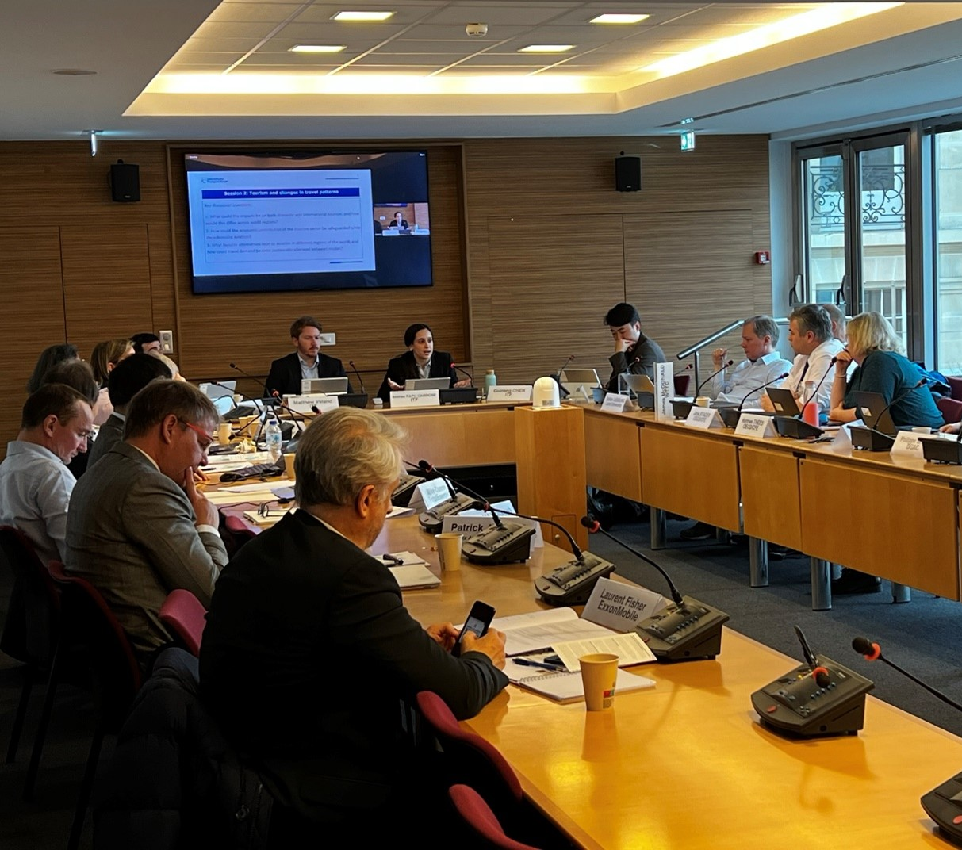
Workshop objectives
The workshop saw discussions focused on the potential consequences of decarbonising aviation and principles to mitigate adverse effects. The discussion was organized around three key topic areas:
      Connectivity and Technology;
      Macroeconomic impact and Tourism;
      Social and Labour.
Specific attention was given to differences across world regions, geographies and societal cohorts.
A participative exercise was facilitated to collect expert insights on the strengths and challenges of different policy interventions to decarbonise aviation. Eight policy interventions were discussed with respect to four criteria: effectiveness, efficiency, equity, and feasibility.

Slide 5
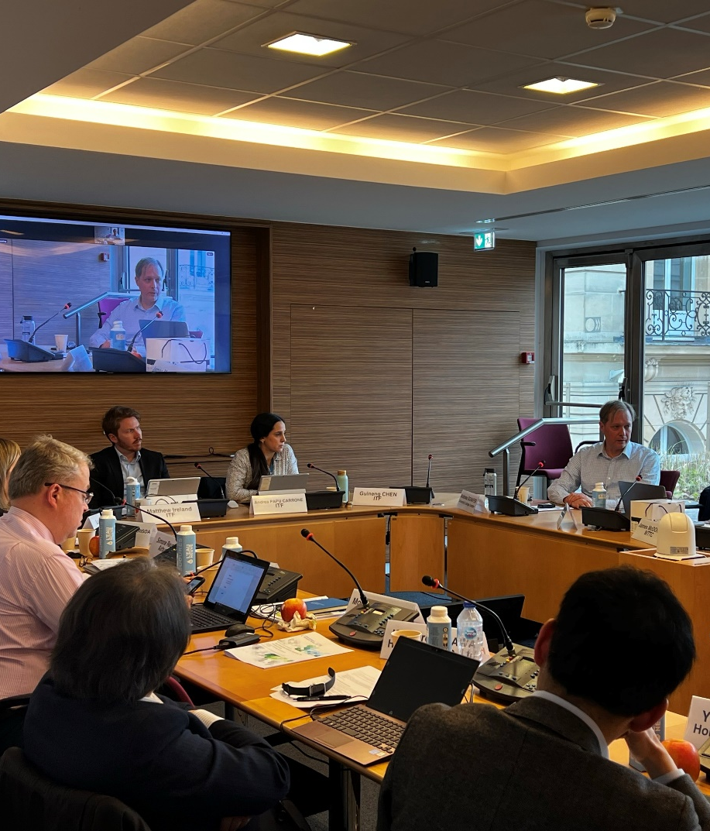
Workshop summary
The workshop convened experts from various sectors of the aviation and energy industry, the public sector, and tourism and labour international organisations. The introductory session led by the ITF outlined the project's objectives. The ITF Global Non-urban Passenger Model was presented as a tool to assess impacts on air connectivity, travel demand and CO₂ emissions under different decarbonization scenarios. differences.
The subsequent sessions focused on discussing the potential consequences of decarbonising aviation on connectivity, tourism and the wider-economy, and on society and the labour market. Each session featured presentations from academics, key industry stakeholders, and experts representing organizations such as the OECD, WTTC, ILO, FIATA, and the International Transport Workers Federation. Conversations underscored the necessity for holistic approaches that tackle the interdependence among air transport, tourism, energy, and overall economic development.
During the final session of the workshop, a participative multi-criteria decision analysis exercise was carried out to spur discussion around a) which policies are the most important for decarbonisiation aviation, b) their associated trade-offs against a set of agreed criteria, and c) how these policies could be designed in such a way to best take account of the wider consequences of decarbonisation as explored earlier in the day.
The workshop provided valuable insights into the complexities of decarbonising air transport and emphasised the imperative of adopting sustainable and equitable policies for a just transition to aviation emissions reduction.

Slide 6
Participative multi-criteria decision analysis results
While many potential policy interventions exist for decarbonising aviation, the participative multi-criteria decision analysis exercise only focused on eight broad categories.
Participants first weighted four criteria by allocating 100 points between them, based on their perception of the relative importance of each in assessing options to decarbonise aviation. The four criteria were; Effectiveness, Efficiency, Equity, and Feasibility. Participants then ranked each of the eight policy interventions against each criterion on a five point scale, where one indicated very weak performance against the criterion and five indicated very strong performance. Performance scores were then multiplied by the criterion’s weighting to calculate a weighted performance score for each policy intervention against each criterion. The figure on the right plots these scores on a radar diagram.
While not to be considered an authoritative assessment of these policies, the exercise fostered discussion among participants as to the relative trade-offs of different interventions against a consistent set of criteria. This approach can help deepen understanding as to how policies for decarbonising aviation can be designed and implemented in ways which take account of, and mitigate, their wider consequences.
19 workshop participants completed the exercise; 9 from the private sector, 5 from industry representative bodies, 2 from intergovernmental organisations, 2 from academia, and 1 from a national government administration).

Slide 7
Broader consequences of decarbonising aviation:
Insights and Way Forward
Address potential connectivity challenges related to higher operation costs
Promote the development of tourism within the decarbonisation context
Ensure a just transition accounting for social and labour impacts

Slide 8
Address potential connectivity challenges related to higher operation costs
Promote the development of tourism within the decarbonisation context
Ensure a just transition accounting for social and labour impacts
Preserving worldwide connectivity while substantially reducing aviation carbon emissions emerged as a main priority. Decarbonising aviation will likely trigger higher air transport costs that might impact connectivity. Experts' views on the magnitude of such air connectivity impacts ranged from not seeing major changes in global route connectivity to expecting an increase of direct route flights and a rise in costs of transport for aviation dependent countries. The final report will provide recommendations to address potential impacts on connectivity and safeguard the fundamental worldwide transport network that enables global business, world trade and social wellbeing.
Promoting the development of the tourism industry within the decarbonisation context is essential. Tourism carbon footprint is high, with almost 60% of international tourist globally travelling by air. Promoting more sustainable tourism practices such as: shorter distance destination selection, longer stays and the use of cleaner alternative modes to aviation can reduce the impact of transport on total tourism emissions. Forward-looking agendas that prioritize tourism positive impact on local communities' development to merely demand growth are crucial to support the transition to low carbon emissions.
Integrating social and labour considerations into policy decisions was emphasized as a critical path to ensure a just transition to aviation net-zero. While aviation undoubtedly contributes to social interaction and well-being, it is responsible for approximately 2.5% of global CO2 emissions. Although this figure is lower compared to other industries, it is emitted by a disproportionately small segment of the global population. Current estimates suggest that 1% of the world’s population accounts for more than half of aviation-related emissions. The final report will further explore the social equity of air travel taxation.
Moreover, achieving a just transition in decarbonizing aviation must take into account the potential impacts on the labor force. Broadening the dialogue and ensuring diverse stakeholder participation in decarbonization discussions will be crucial to mitigating negative impacts on aviation workers and safeguarding their rights throughout this process.

Slide 9
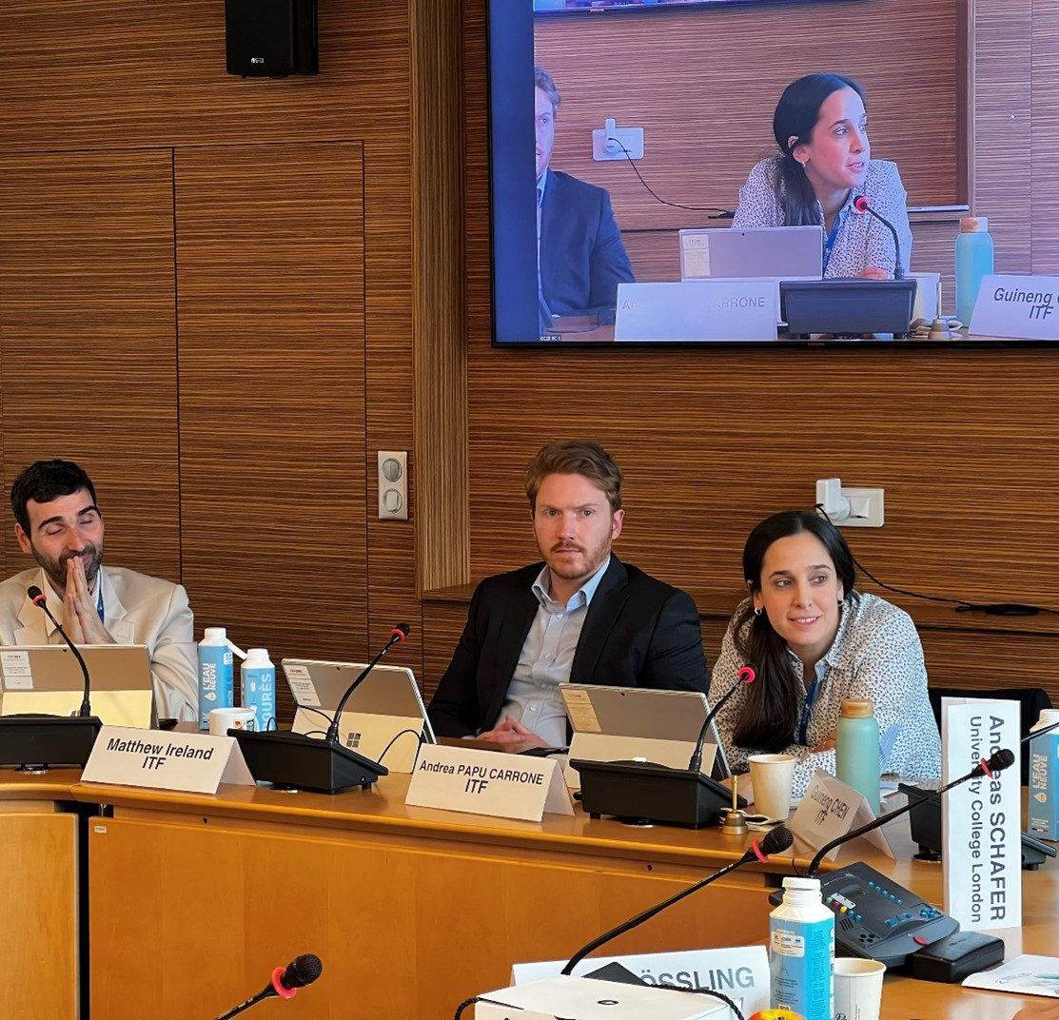
Andrea PAPU CARRONE
Project Manager, Modeller / Analyst
Andrea.PAPUCARRONE@itf-oecd.org
Matthew IRELAND
Project Manager / Policy Analyst
Matthew.IRELAND@itf-oecd.org
Sharon MASTERSON
Manager, Corporate Partnership Board sharon.masterson@itf-oecd.org
What’s next?
Contact us
The workshop insights will help shape the recommendations in the final ITF/CPB report, set to be published in Q4 2024.

Slide 10

CPB members

